Slide 1

[ ] Inc.
REDACTED

Slide 2



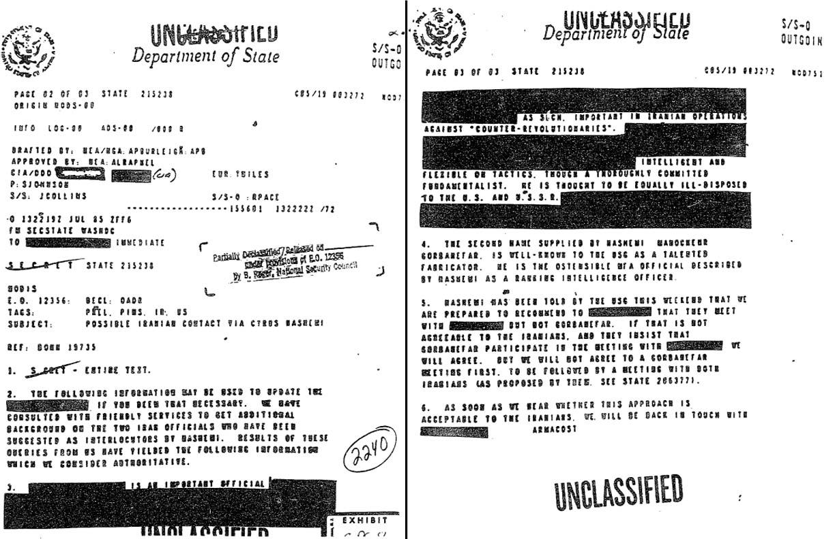
[ ] Inc.
REDACTED

Slide 3
[ ] Inc.
REDACTED
Target Clients
Legal entities who need to redact sensitive information from legal documents.
Businesses that need to comply with privacy laws (e.g., GDPR, HIPAA).
Individuals who want to anonymize personal information in images or documents before sharing.
Services Offered
Text redaction in documents.
Image redaction (e.g., blurring faces, license plates).
Custom redactions based on client specifications.
Key Processes
Document submission by clients.
Redaction processing based on client instructions.
Review and approval of redacted materials by clients.
Invoicing and payments based on redaction projects.

Slide 4
[ ] Inc.
REDACTED
CLIENTS(ID (PK), Name, Email, Phone)
DOCUMENTS(ID (PK), ClientID (FK), DocumentType, SubmissionDate)
REDACTIONS(ID (PK), DocumentID (FK), RedactionType, Description, Status)
REVIEWS(ID (PK), DocumentID (FK), ReviewDate, ApprovalStatus)
INVOICES(ID (PK), ClientID (FK), InvoiceDate, TotalAmount, DueDate, PaymentStatus)
INVOICEITEMS(ID (PK), InvoiceID (FK), Description, Amount, Quantity)
PAYMENTS(ID (PK), InvoiceID (FK), PaymentDate, Amount, PaymentMethod)
CLIENT_DOCUMENTS
CLIENTS.ID -> DOCUMENTS.ClientID
Cardinality: One CLIENTS can have many DOCUMENTS
DOCUMENT_REDACTIONS
DOCUMENTS.ID -> REDACTIONS.DocumentID
Cardinality: One DOCUMENT can have many REDACTIONS
DOCUMENT_REVIEWS
DOCUMENTS.ID -> REVIEWS.DocumentID
Cardinality: One DOCUMENT can have many REVIEWS
CLIENT_INVOICES
CLIENTS.ID -> INVOICES.ClientID
Cardinality: One CLIENTS can have many INVOICES
INVOICE_INVOICEITEMS
INVOICES.ID -> INVOICEITEMS.InvoiceID
Cardinality: One INVOICES can have many INVOICEITEMS
INVOICE_PAYMENTS
INVOICES.ID -> PAYMENTS.InvoiceID
Cardinality: One INVOICES can have many PAYMENTS

Slide 5
[ ] Inc.
REDACTED
CLIENTS(ID (PK), Name, Email, Phone)
FD1: ID -> Name, Email, Phone
DOCUMENTS(ID (PK), ClientID (FK), DocumentType, SubmissionDate)
FD1: ID -> ClientID, DocumentType, SubmissionDate
REDACTIONS(ID (PK), DocumentID (FK), RedactionType, Description, Status)
FD1: ID -> DocumentID, RedactionType, Description, Status
REVIEWS(ID (PK), DocumentID (FK), ReviewDate, ApprovalStatus)
FD1: ID -> DocumentID, ReviewDate, ApprovalStatus
INVOICES(ID (PK), ClientID (FK), InvoiceDate, TotalAmount, DueDate, PaymentStatus)
FD1: ID -> ClientID, InvoiceDate, TotalAmount, DueDate, PaymentStatus
INVOICEITEMS(ID (PK), InvoiceID (FK), Description, Amount, Quantity)
FD1: ID -> InvoiceID, Description, Amount, Quantity
PAYMENTS(ID (PK), InvoiceID (FK), PaymentDate, Amount, PaymentMethod)
FD1: ID -> InvoiceID, PaymentDate, Amount, PaymentMethod

Slide 6
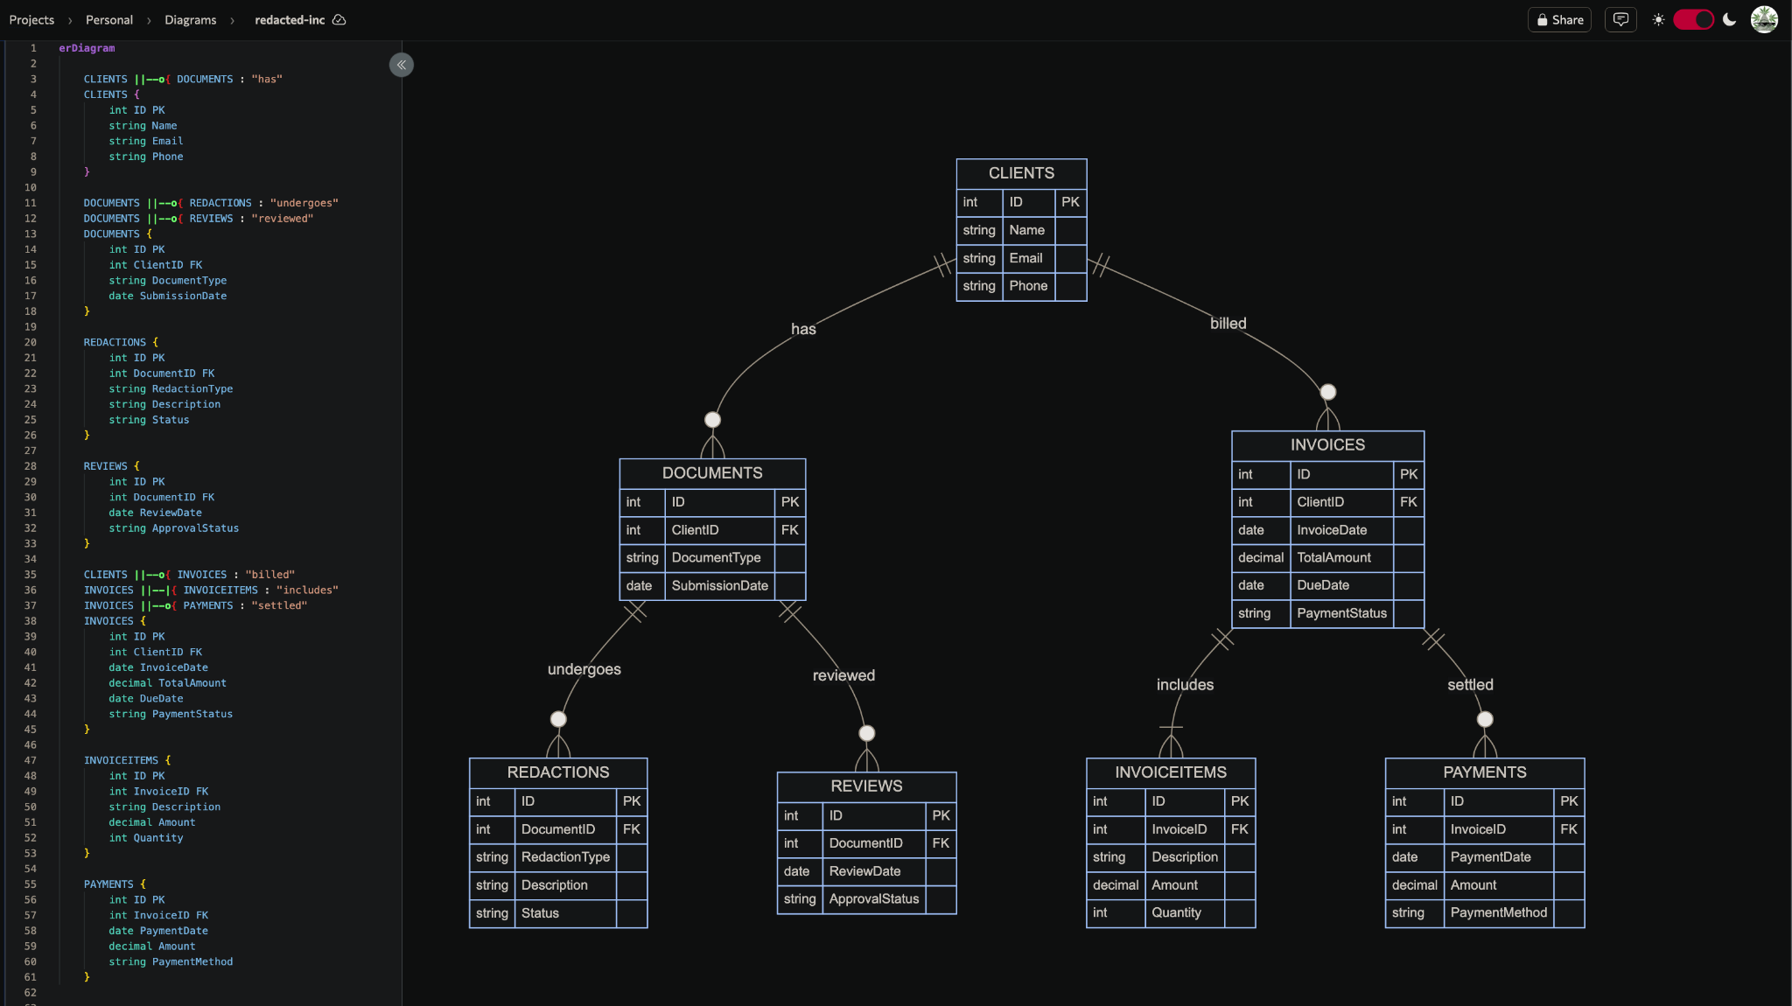
[ ] Inc.
REDACTED

Slide 7
[ ] Inc.
REDACTED
CLIENTS(ID (PK), Name, Email, Phone)
FD1: ID -> Name, Email, Phone
DOCUMENTS(ID (PK), ClientID (FK), DocumentType, SubmissionDate)
FD1: ID -> ClientID, DocumentType, SubmissionDate
REDACTIONS(ID (PK), DocumentID (FK), RedactionType, Description, Status)
FD1: ID -> DocumentID, RedactionType, Description, Status
REVIEWS(ID (PK), DocumentID (FK), ReviewDate, ApprovalStatus)
FD1: ID -> DocumentID, ReviewDate, ApprovalStatus
INVOICES(ID (PK), ClientID (FK), InvoiceDate, TotalAmount, DueDate, PaymentStatus)
FD1: ID -> ClientID, InvoiceDate, TotalAmount, DueDate, PaymentStatus
INVOICEITEMS(ID (PK), InvoiceID (FK), Description, Amount, Quantity)
FD1: ID -> InvoiceID, Description, Amount, Quantity
PAYMENTS(ID (PK), InvoiceID (FK), PaymentDate, Amount, PaymentMethod)
FD1: ID -> InvoiceID, PaymentDate, Amount, PaymentMethod

Slide 8
[ ] Inc.
REDACTED
CLIENTS and DOCUMENTS:
Relationship: "has"
Cardinality: One CLIENT can have zero or many DOCUMENTS. Each DOCUMENT is associated with exactly one CLIENT.
Participation: Optional for DOCUMENTS and Mandatory for CLIENTS.
DOCUMENTS and REDACTIONS:
Relationship: "undergoes"
Cardinality: One DOCUMENT can have zero or many REDACTIONS. Each REDACTION is associated with exactly one DOCUMENT.
Participation: Optional for REDACTIONS and Mandatory for DOCUMENTS.
DOCUMENTS and REVIEWS:
Relationship: "reviewed"
Cardinality: One DOCUMENT can be reviewed zero or many times. Each REVIEW is associated with exactly one DOCUMENT.
Participation: Optional for REVIEWS and Mandatory for DOCUMENTS.
CLIENTS and INVOICES:
Relationship: "billed"
Cardinality: One CLIENT can have zero or many INVOICES. Each INVOICE is associated with exactly one CLIENT.
Participation: Optional for INVOICES and Mandatory for CLIENTS.
INVOICES and INVOICEITEMS:
Relationship: "includes"
Cardinality: One INVOICE can include one or many INVOICEITEMS. Each INVOICEITEM is associated with exactly one INVOICE.
Participation: Mandatory for both INVOICES and INVOICEITEMS.
INVOICES and PAYMENTS:
Relationship: "settled"
Cardinality: One INVOICE can be settled by zero or many PAYMENTS. Each PAYMENT is associated with exactly one INVOICE.
Participation: Optional for PAYMENTS and Mandatory for INVOICES.
CLIENTS(ID (PK), Name, Email, Phone)
DOCUMENTS(ID (PK), ClientID (FK), DocumentType, SubmissionDate)
REDACTIONS(ID (PK), DocumentID (FK), RedactionType, Description, Status)
REVIEWS(ID (PK), DocumentID (FK), ReviewDate, ApprovalStatus)
INVOICES(ID (PK), ClientID (FK), InvoiceDate, TotalAmount, DueDate, PaymentStatus)
INVOICEITEMS(ID (PK), InvoiceID (FK), Description, Amount, Quantity)
PAYMENTS(ID (PK), InvoiceID (FK), PaymentDate, Amount, PaymentMethod)

Slide 9
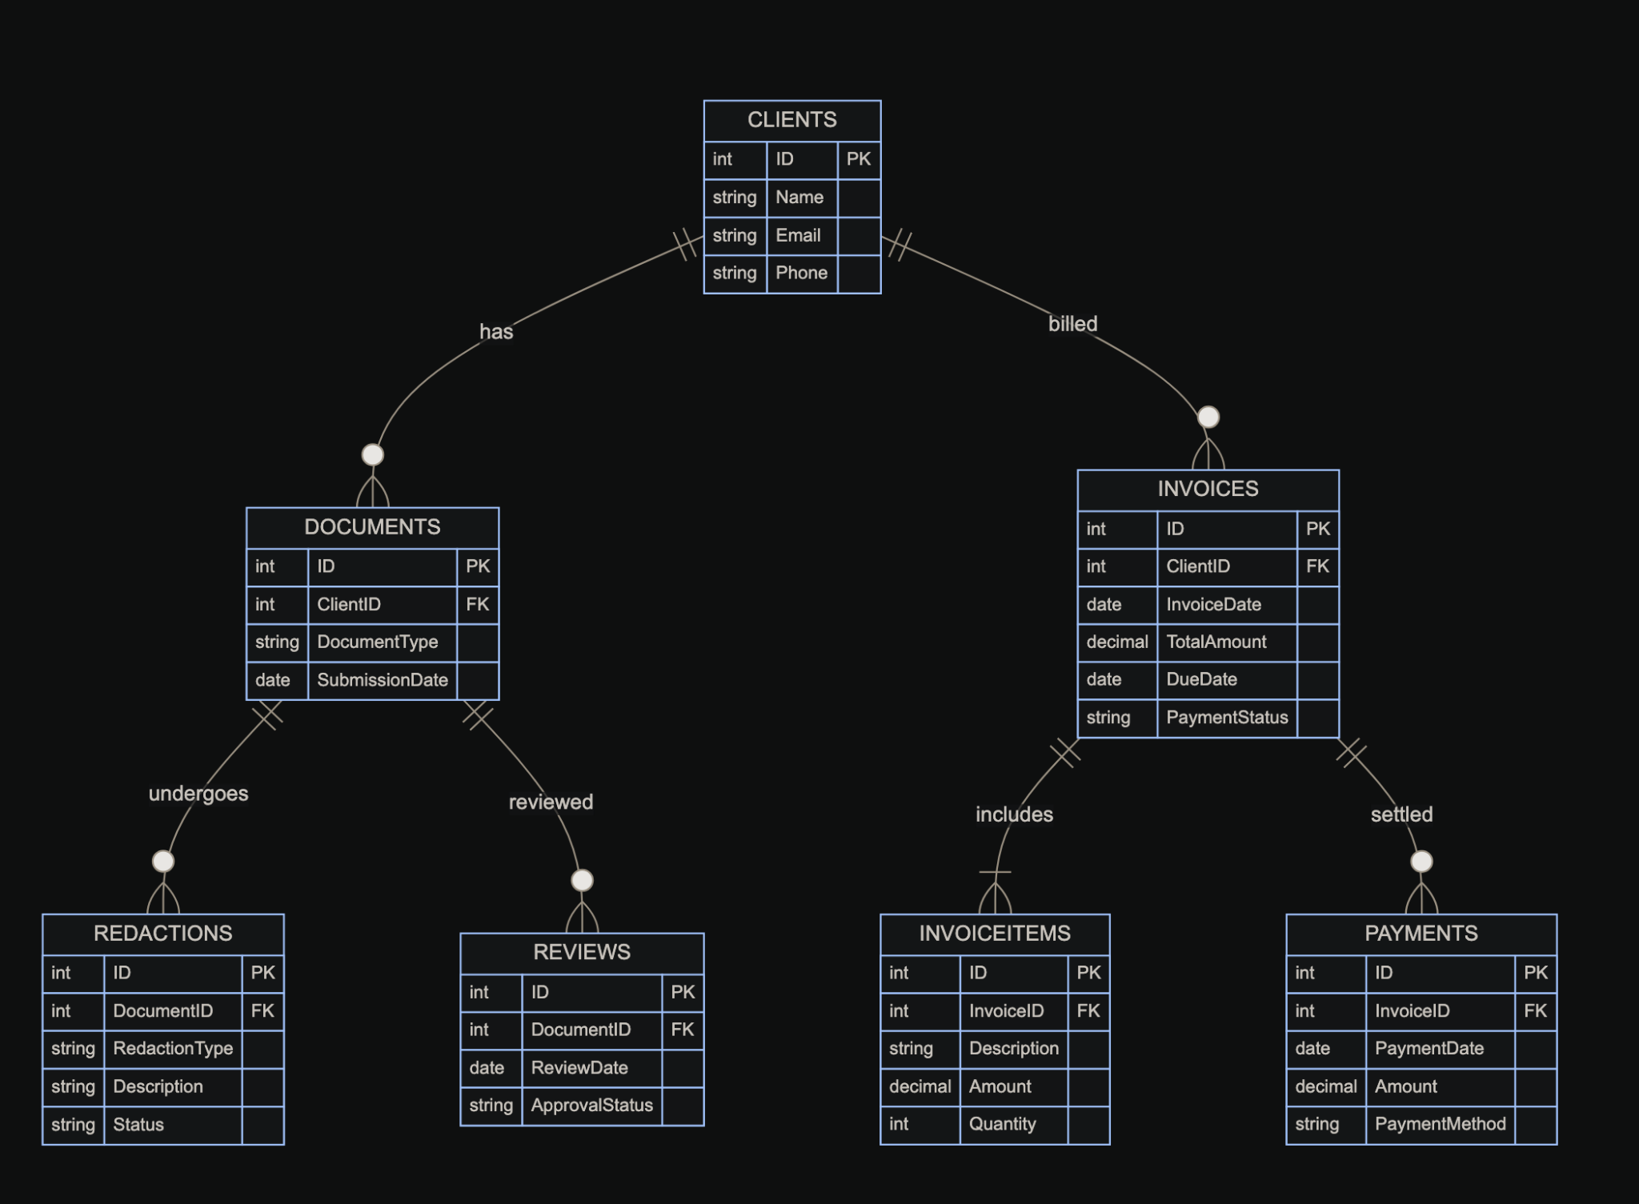
[ ] Inc.
REDACTED
1NF
Every attribute is atomic. There are no repeating groups or arrays.
All entries in a column are of the same data type.
Each column has a unique name.
The order in which data is stored does not affect the database's integrity.
CLIENTS(ID (PK), Name, Email, Phone)
FD1: ID -> Name, Email, Phone
DOCUMENTS(ID (PK), ClientID (FK), DocumentType, SubmissionDate)
FD1: ID -> ClientID, DocumentType, SubmissionDate
REDACTIONS(ID (PK), DocumentID (FK), RedactionType, Description, Status)
FD1: ID -> DocumentID, RedactionType, Description, Status
REVIEWS(ID (PK), DocumentID (FK), ReviewDate, ApprovalStatus)
FD1: ID -> DocumentID, ReviewDate, ApprovalStatus
INVOICES(ID (PK), ClientID (FK), InvoiceDate, TotalAmount, DueDate, PaymentStatus)
FD1: ID -> ClientID, InvoiceDate, TotalAmount, DueDate, PaymentStatus
INVOICEITEMS(ID (PK), InvoiceID (FK), Description, Amount, Quantity)
FD1: ID -> InvoiceID, Description, Amount, Quantity
PAYMENTS(ID (PK), InvoiceID (FK), PaymentDate, Amount, PaymentMethod)
FD1: ID -> InvoiceID, PaymentDate, Amount, PaymentMethod

Slide 10
[ ] Inc.
REDACTED
2NF
It is in 1NF.
All non-key attributes are fully functionally dependent on the primary key.
CLIENTS(ID (PK), Name, Email, Phone)
FD1: ID -> Name, Email, Phone
DOCUMENTS(ID (PK), ClientID (FK), DocumentType, SubmissionDate)
FD1: ID -> ClientID, DocumentType, SubmissionDate
REDACTIONS(ID (PK), DocumentID (FK), RedactionType, Description, Status)
FD1: ID -> DocumentID, RedactionType, Description, Status
REVIEWS(ID (PK), DocumentID (FK), ReviewDate, ApprovalStatus)
FD1: ID -> DocumentID, ReviewDate, ApprovalStatus
INVOICES(ID (PK), ClientID (FK), InvoiceDate, TotalAmount, DueDate, PaymentStatus)
FD1: ID -> ClientID, InvoiceDate, TotalAmount, DueDate, PaymentStatus
INVOICEITEMS(ID (PK), InvoiceID (FK), Description, Amount, Quantity)
FD1: ID -> InvoiceID, Description, Amount, Quantity
PAYMENTS(ID (PK), InvoiceID (FK), PaymentDate, Amount, PaymentMethod)
FD1: ID -> InvoiceID, PaymentDate, Amount, PaymentMethod

Slide 11
[ ] Inc.
REDACTED
3NF
It is in 2NF.
It has no transitive dependencies.
CLIENTS(ID (PK), Name, Email, Phone)
FD1: ID -> Name, Email, Phone
DOCUMENTS(ID (PK), ClientID (FK), DocumentType, SubmissionDate)
FD1: ID -> ClientID, DocumentType, SubmissionDate
REDACTIONS(ID (PK), DocumentID (FK), RedactionType, Description, Status)
FD1: ID -> DocumentID, RedactionType, Description, Status
REVIEWS(ID (PK), DocumentID (FK), ReviewDate, ApprovalStatus)
FD1: ID -> DocumentID, ReviewDate, ApprovalStatus
INVOICES(ID (PK), ClientID (FK), InvoiceDate, TotalAmount, DueDate, PaymentStatus)
FD1: ID -> ClientID, InvoiceDate, TotalAmount, DueDate, PaymentStatus
INVOICEITEMS(ID (PK), InvoiceID (FK), Description, Amount, Quantity)
FD1: ID -> InvoiceID, Description, Amount, Quantity
PAYMENTS(ID (PK), InvoiceID (FK), PaymentDate, Amount, PaymentMethod)
FD1: ID -> InvoiceID, PaymentDate, Amount, PaymentMethod

Slide 12
[ ] Inc.
REDACTED
CLIENTS(ID (PK), Name, Email, Phone)
FD1: ID -> Name, Email, Phone
DOCUMENTS(ID (PK), ClientID (FK), DocumentType, SubmissionDate)
FD1: ID -> ClientID, DocumentType, SubmissionDate
REDACTIONS(ID (PK), DocumentID (FK), RedactionType, Description, Status)
FD1: ID -> DocumentID, RedactionType, Description, Status
REVIEWS(ID (PK), DocumentID (FK), ReviewDate, ApprovalStatus)
FD1: ID -> DocumentID, ReviewDate, ApprovalStatus
INVOICES(ID (PK), ClientID (FK), InvoiceDate, TotalAmount, DueDate, PaymentStatus)
FD1: ID -> ClientID, InvoiceDate, TotalAmount, DueDate, PaymentStatus
INVOICEITEMS(ID (PK), InvoiceID (FK), Description, Amount, Quantity)
FD1: ID -> InvoiceID, Description, Amount, Quantity
PAYMENTS(ID (PK), InvoiceID (FK), PaymentDate, Amount, PaymentMethod)
FD1: ID -> InvoiceID, PaymentDate, Amount, PaymentMethod

Slide 13
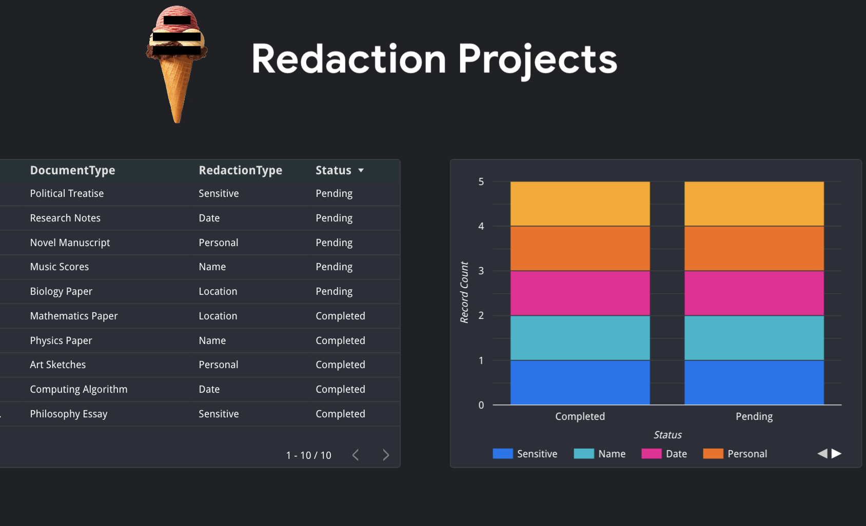
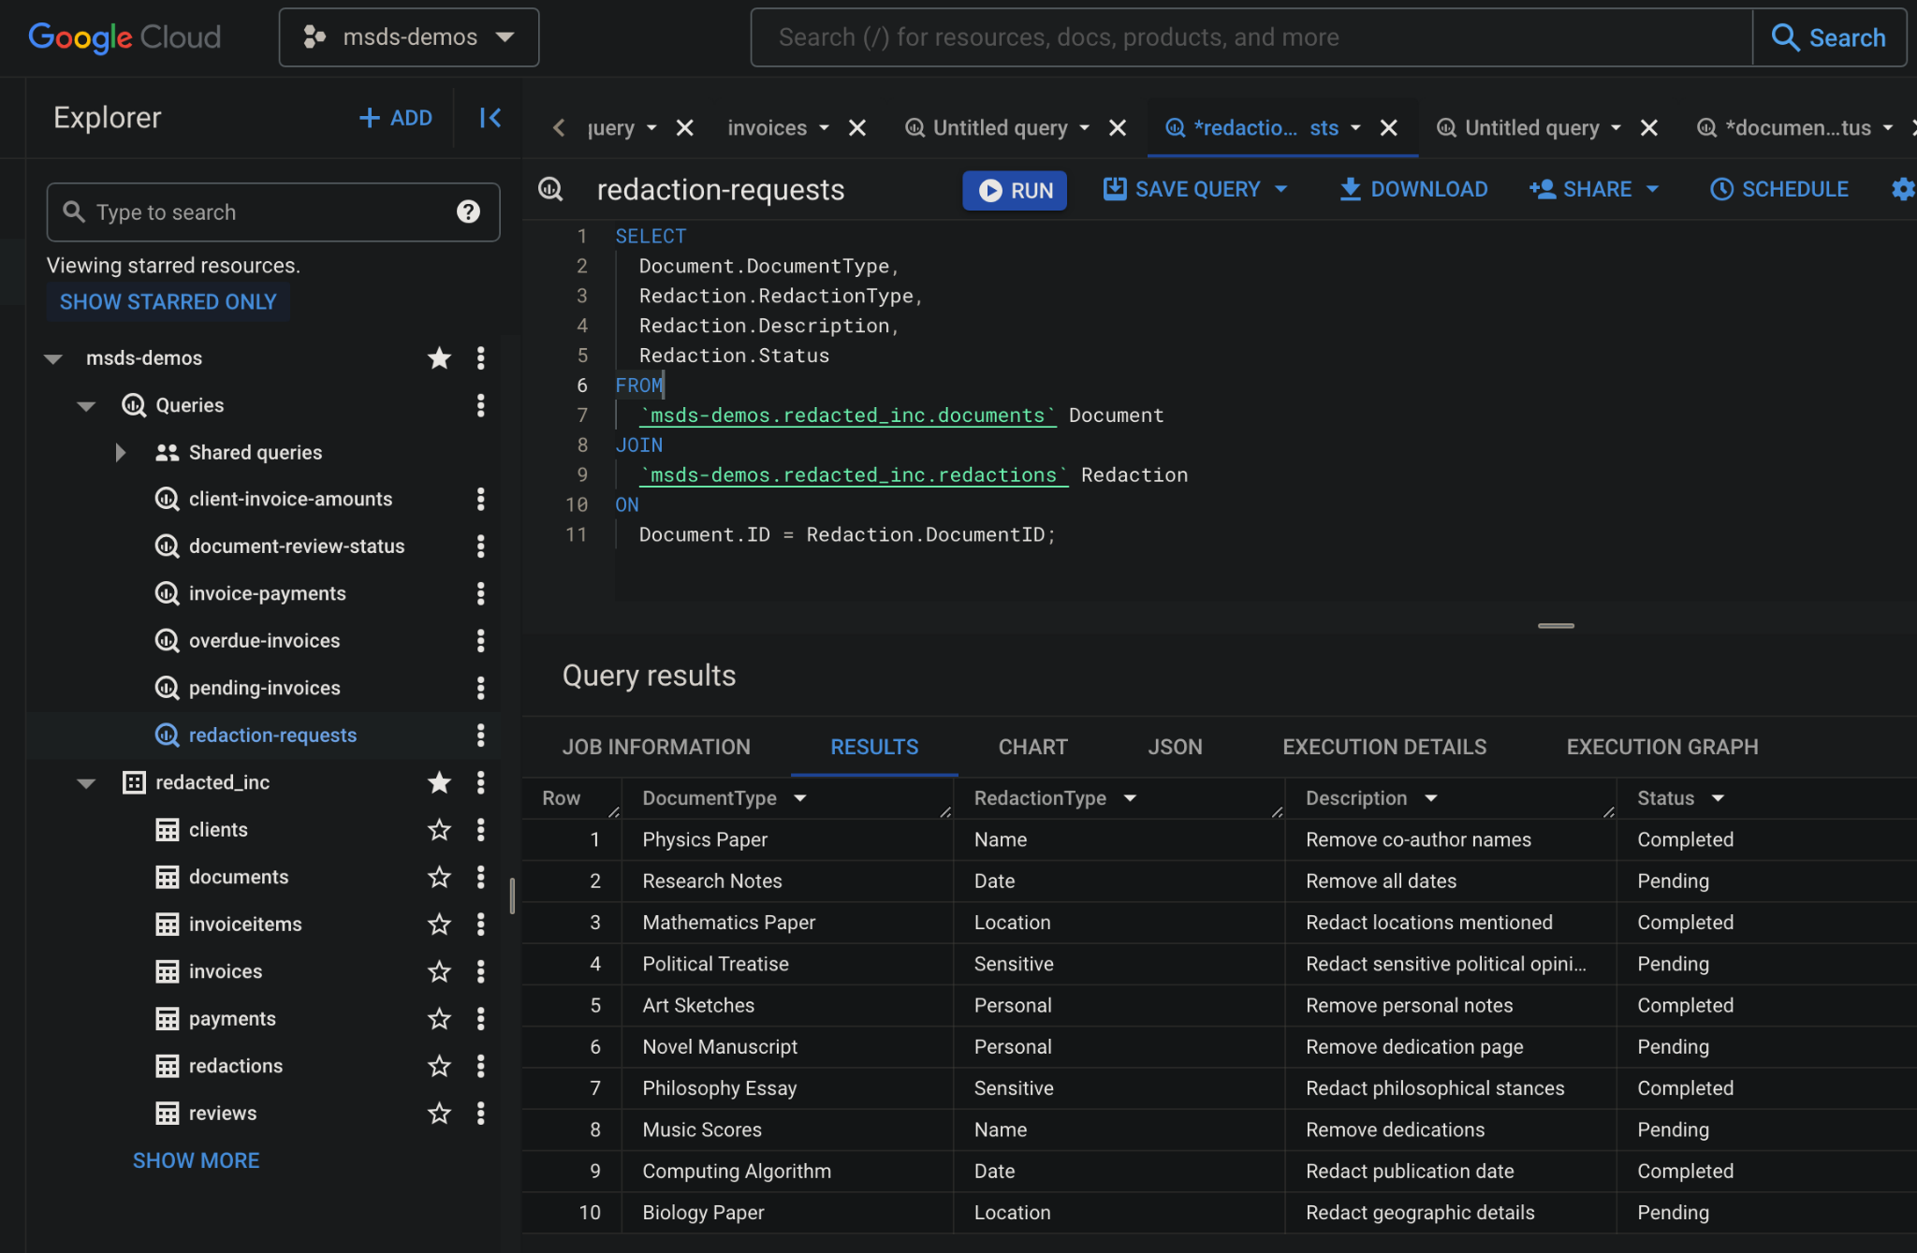
[ ] Inc.
REDACTED

Slide 14

[ ] Inc.
REDACTED
Thank you!
https://github.com/g33k5z/redacted-inc

Slide 15
[ ] Inc.
REDACTED

Slide 16
[ ] Inc.
REDACTED

